Slide 1
MULTIMEDIA AUTHORING IN EDUCATION

Slide 2
OBJECTIVES
By the end of the lesson, students will be able to;
Explain multimedia
Describe the elements of multimedia
Differentiate between multimedia and mass media
Discuss the need for media in education

Slide 3
Multimedia Defined
The word “multimedia” is composed of two parts; that is,
Multi – which means numerous or multiple
Media (singular, medium,)
In Latin, Medium means “Between”.
Media refers to anything that carries information between a source and a receiver.

Slide 4
MULTIMEDIA
Multimedia is use of two or more elements to convey information to and audience.
The elements of multimedia include; audio, video, text, graphics and animation.

Slide 5
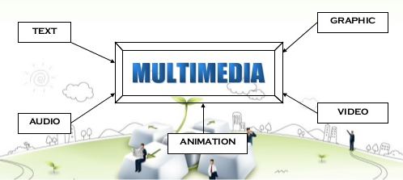
ELEMENTS OF MULTIMEDIA

Slide 6
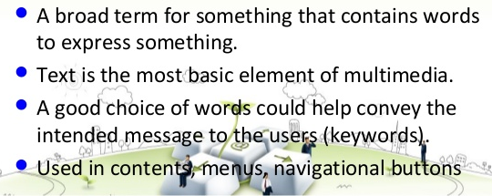
TEXT

Slide 7

TEXT

Slide 8
Graphics
Two or three dimensional figure or illustration
Could be produced manually (by drawing, painting, carving, e.t.c.) or by computer graphics technology
Examples are photographs, drawings, Line art, graphs, diagrams, typography, numbers, symbols, geometric designs, maps, engineering drawings, or other images.

Slide 9

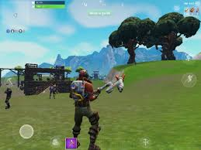

Slide 10
Audio
A multimedia application may require the use of speech, music and sound effects.
These are called audio or sound element of multimedia. Speech is also a perfect way for teaching.
Audio are of analog and digital types. Analog audio or sound refers to the original sound signal. Computer stores the sound in digital form.

Slide 11



Slide 12
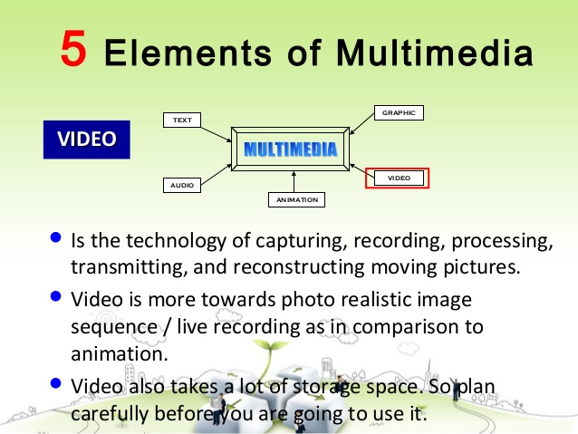
VIDEO

Slide 13
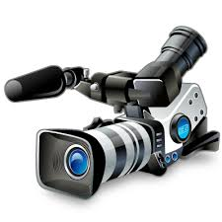
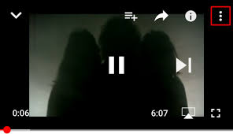

Slide 14
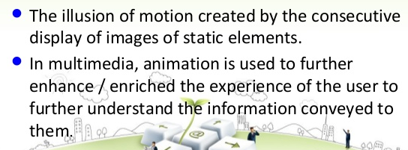
ANIMATIONS

Slide 15
MASS MEDIA VS. MULTIMEDIA
Mass media is communication that is to a large group, or groups, of people in a short time.
This can be written, spoken or broadcast communication.
Some of the most popular forms of mass media are newspapers, magazines, radio, social media, television, Internet, and films/movies.

Slide 16
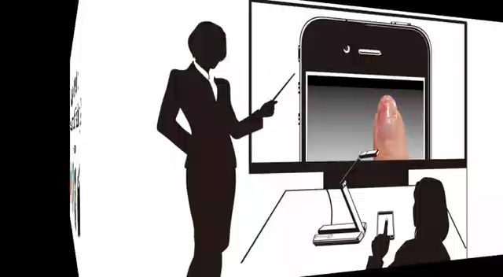
Use of multimedia in education

Slide 17

Discussion
From the video, why is there the need for the use of Multimedia in teaching and learning?
What factors should be considered when integration Multimedia in class?
What are the challenges to the effective use of Multimedia in education?

Slide 18
Why multimedia in education?
Multimedia is used to capture attention,
Engage learners,
Explain difficult concepts,
Inspire creativity and have fun
Encourages deep reflective thinking and provides valuable learning opportunities

Slide 19
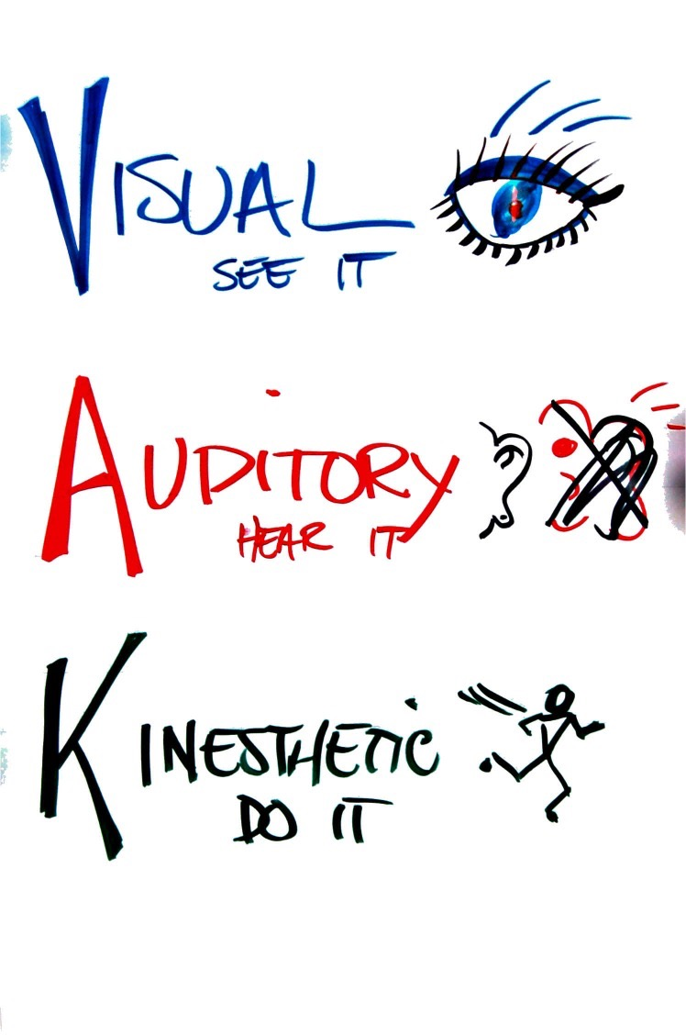
Why multimedia?
Caters for all types of learning

Slide 20
Challenges
Individual: teacher-level barriers
inadequate time,
lack of confidence,
resistance to change
Institutional: school-level barriers
lack of effective training in solving technical problems
lack of access to resources

Slide 21
Finding Multimedia Resources

Slide 22

Downloading Multimedia From the Web
Downloading using Google Images
Use “advance search” etc to improve images searches
Size, type, colour, source, etc

Slide 23
Where to find Images
You can obtain images from various sites including the following
google.com
pexels.com
pixabay.com
unsplash.com
stocksnap.io
flickr.com

Slide 24
Downloading videos From the Web
Downloading videos: Open any of the following
4kdownloader
Real player
SaveFrom:
http://en.savefrom.net/
VDyoutube
https://www.vdyoutube.com/
Keepdownloading
https://www.keepdownloading.com/

Slide 25
Downloading Video From The Web
Using Savefrom/Vdyoutube/keepdownloading
Go to Youtube.com
Select the video file
Start playing the file
Copy the URL in YouTube address Bar

Slide 26
Authoring Systems
These are programs which has pre-programmed elements for the development of interactive multimedia presentations. These systems also help to write hypertext or multimedia applications.
Examples include Microsoft PowerPoint, Adobe Flash, TechSmith Camtasia, Articulate Studio, Adobe Captivate, U-Lead Studio, etc.

Slide 27
Multimedia Authoring
Multimedia authoring is a process of assembling different types of media contents like text, audio, image, animations and video as a single stream of information with the help of various software tools available in the market.
Multimedia authoring can also simply mean creation of multimedia products such as movies, presentations or interactive applications with the help of multimedia systems or applications.

Slide 28
Advantages of Authoring Systems
Authoring systems contributes to interactive lessons development and delivery
They also provide low level computer users the power to design their own multimedia content with little or no difficulty.
Authoring tools give teachers the power to design lessons to cater for all learning styles.
Authoring tools like PowerPoint can be used as an instructional tool and at the same time a productivity tools.
The content creation (graphics, text, video, audio, animation) is not affected by choice of authoring system
Authoring systems can speed up programming and development of multimedia content

Slide 29
How Authoring Tools Impact Learning
Authoring tools have become the perfect solution to capture the attention of your audience in the easiest, fastest, and most impactful way.
Authoring tools help tutors deliver interactive lessons and also support advanced learning and training course material development.
Many computer games with focus on education are now available which help to stimulate and motivate the students.
The tool provides assistance to teachers and students in putting together simple presentations.

Slide 30
Features of Authoring Tools
Editing features
Interactivity features
Playback features
Hypertext
Internet playability
Cross-Platform capabilities
Visual programming with icons or objects

Slide 31
COURSEWARE
Courseware simply refers to educational software.
It is defined as instructional material in an interactive mode to facilitate and control the individualized learning environment for students. It can be used to provide instructional material to a group of students or for individual students.

Slide 32
Categories of Courseware
Drill and practice
Tutorial
Problem solving
Gaming
Simulation

Slide 33
Drill and Practice
This involves leading the student through a series of examples where he/she can practice the material already learned or can have it repeated for him/her.
The assumption with a drill-and-practice system is that the student has already had the concept presented to him, that the material has been seen before, and the purpose now is to gain familiarity and develop some familiarity with the ideas.
The frequency of repetition should have a direct effect on achievement. Drill-and-practice-based lessons can be an effective means of teaching students of varying learning styles.

Slide 34
Tutorial
This approach implies a series of four steps in the teaching of any given concept:
stating the item of knowledge that is to be taught;
clarifying and elaborating the item in a series of sentences;
restating the item to improve understanding; and
making a transition to the next concept or item to be taught.

Slide 35
Problem Solving
Problem-solving is a process—an ongoing activity in which we take what we know to discover what we don’t know.
Problem-solving aims at presenting the knowledge to be learnt in the form of a problem. It begins with a problematic situation and consists of continuous, meaningful, well-integrated activity.
It may be a purely mental difficulty or it may be physical and involve manipulation of data. Problem-solving is the ability to identify and solve problems by applying appropriate skills systematically.

Slide 36
Simulation
Simulation is the technique of representing the real world (mostly activity) by a computer program.
In simulation, the student is given a programmed model to use, not asked to write or change this program. He/she only observe and or interact with the simulation model or program.
Simulation can be summarised in learning as “learning by seeing”. It allows realistic practice without the expense or risk otherwise involved.

Slide 37
Gaming
Gaming also sometimes called gamification incorporates the most motivational aspects of games (e.g., badges awarded for success) into nongame activities. In this process, students are rewarded upon successful achievement of an objective. This motivates students to put up more efforts. Also driving interest and rewarding student achievement can increase the time spent on learning activities

Slide 38
Advantages and disadvantages of drill and practice, tutorials, simulation, gaming problem solving.?????

Slide 39
Authoring Interface
An interface is the platform where the use interacts with the system. The interface of an authoring tool plays an important role in attracting the users to use the tool.
An appropriate graphical user interface should be selected for different multimedia applications, which naturally have different roles to extend. In the authoring environment, the authoring interface is referred to as the authoring metaphor.

Slide 40
Interface Metaphors
Slide Show Metaphor
Book Metaphor
TimeLine Metaphor
Icon Metaphor

Slide 41
Slide show metaphor
Each screen of a presentation is seen as a slide object. This metaphor is an excellent choice for authoring linear presentations. It is a linear presentation by default but can be used for somehow non-linear presentations.
Some examples of current tools that apply this metaphor are Microsoft’s PowerPoint and Lotus’s Freelance.

Slide 42
Book metaphor
In this metaphor, the application is thought of as a book containing many numbers of pages, which can contain any number of multimedia objects and interactivity.
It is suitable for Encyclopedia, fairy tale story, etc. It also requires programming skills of a certain level.
An example of such a tool is the Asymetrix’s Toolbook

Slide 43
TimeLine metaphor
A timeline metaphor works with a time scale diagram and places objects and events on the time scale in correct relationship. It is especially valuable when dealing with a number of dynamic activities. Some authoring tools that apply this metaphor are Macromedia Director and Action!

Slide 44
Icon Metaphor
The application structure is built by dragging icons from an icon palette into the workplace to form a flow-line of icons. These icons represent objects and events that will occur according to the sequence of the arrangement of the icons.
For example, AimTech’s IconAuthor and Macromedia Authorware.

